Slide 1
RNDJ: an Integrated AI-Powered Platform for Amplifying Marginalized Voices in Policy and Infrastructure Projects
Ryan Lin, Jie He, Dominic Incognito, Nishant Tekwani

Slide 2
General Description and Background
To foster community engagement and ensure that all voices are heard especially those from marginalized communities, we have leveraged AI to create a system that creates a a standardized database and a traversable tree to empower all voices and make sure they are all heard.

Slide 3
Community Feedback and Reporting Platform •This component of the platform will serve as the primary interface for community members to voice their concerns, report issues, and provide feedback on ongoing or upcoming infrastructure projects. •A user-friendly interface, accessible via mobile devices and computers, that supports multiple languages, including voice input for those with low literacy levels. This ensures inclusivity across diverse demographics. •The platform will allow users to submit their concerns anonymously, safeguarding them against potential retaliation while encouraging more open and honest feedback. An AI engine will analyze the submitted feedback, categorizing it by topics such as environmental impact, safety concerns, or community disruption. This analysis will be shared with policymakers and project leaders in real time, ensuring that the feedback is considered in decision-making processes. .

Slide 4
Community Feedback and Reporting Platform – (Data Collection)
Integrating Physical Drop-Off Locations with AI-Powered Platform •Place drop-off boxes in accessible, high-traffic community areas like grocery stores, libraries, and community centers. (Work with local businesses and organizations to host these boxes.) •Provide free cards and pens next to the boxes, with simple prompts and translations in multiple languages. (Include visual aids for low-literacy individuals. •Collect cards weekly, transcribe the content, and integrate it into the digital platform. (Use AI to analyze, categorize, and prioritize the feedback along with digital submissions.) •Inform the community about the drop-off locations through local outreach, flyers, and announcements. •Hold events to demonstrate how feedback is used and how the platform works. Targeting Underrepresented Groups for DEI For example, we need more input from the following groups: •Black/Latino communities (HBCU/HSI for Generation Z) for racial/cultural differences •Immigrant/migrant communities for language/culture barriers •People with disabilities for accessibility issues •Residents from poor regions (low income/lack of educational background) for digital literacy and limited access to technology Multi-platform Data Collection We can collect more data from different sources like phone calls, texts, emails, and social media sites. Then we can use AI to process the data for further analysis.

Slide 5
Demo Time

Slide 6
Functionality
The system will operate in multiple phases.
Phase 1
Take the original community input database and convert each input to a single language and a single conversation style to reduce possible bias.
Phase 2
Generate a summary for each group of 15 user inputs. Then for each two summarize combine them into a single more condensed summary. Repeat this until there is only a single overview summary for all community inputs.

Slide 7
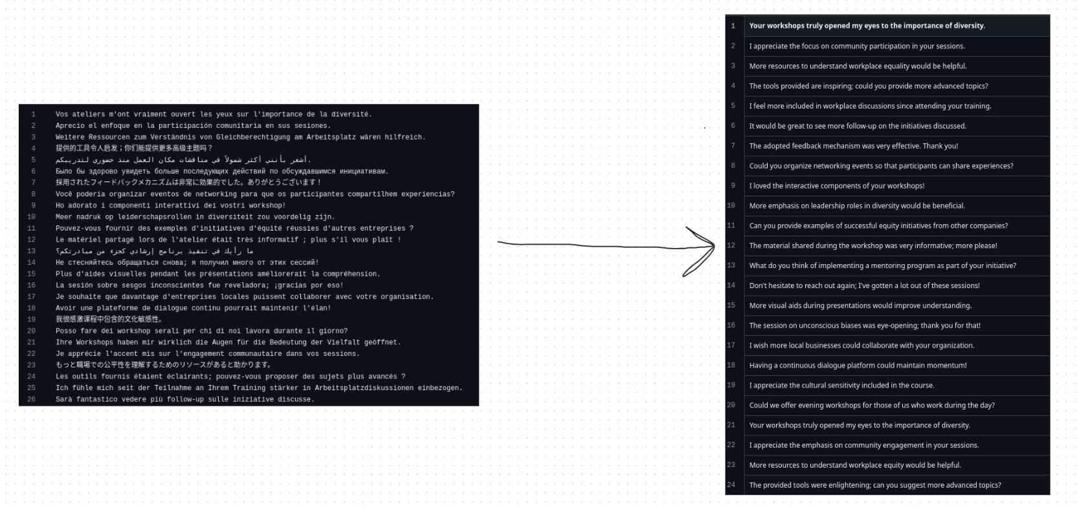

Slide 8
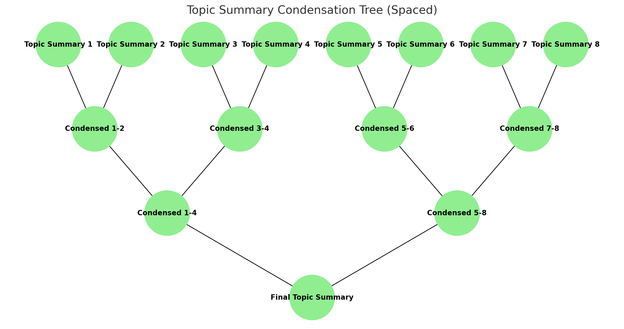
Note: neque digni and in aliquet nisl et a umis varius.

Slide 9
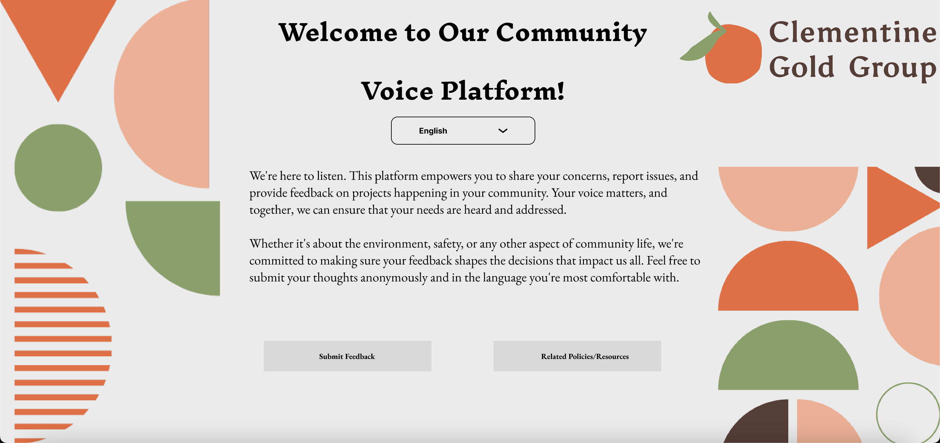

Slide 10
FUTURE DEVELOPMENTS
With more time, more features could be implemented.
For one, each user story could be parsed through and votes could be tallied towards the corresponding topics.
Community input on each topic could be used to create a custom chatbot that works as a community advocate for that topic. It could be given board meeting notes and give a response regarding issues and worries that might arise.
Take audio inputs from phone calls or meetings and add the data to the database of topics
Ensuring usability, add an AI-driven platform to provide digital literacy training, focusing on underrepresented communities

Slide 11
Thank You

